Slide 1
A central remaining problem
How does the brain stabilize MANY synapses at the same time?

Slide 2
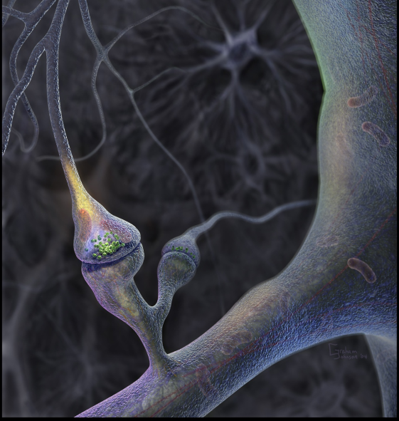
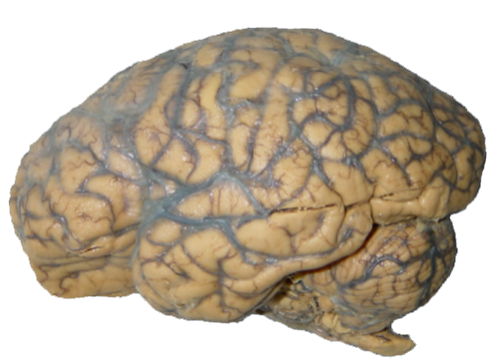
Network Homeostasis as an over-arching principle for
Learning and Development
Homoestasis
Morphogenesis
Funktion
Learning
Structure
Brain constantly changes under the influence of experiences. The overall activity should remain constant (homeostasis). So when new connections are shaped, others disappear, when some connections become stronger others become weaker.
Experiences

Slide 3
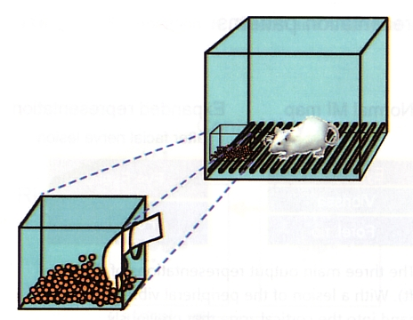
Experience dependent plasticity
Experiment: Rats try to retrieve food pellets from container (difficult).
Results: Accuracy increases if the rats are successful, i.e. if they reach and eat the food. Otherwise there is no significant change.
Kleim et al. (2004)‏

Slide 4
Experience dependent plasticity
Cortical mapping by electrical recordings: Representation of the paw (green) only increases if performance increases. If only motor activity increases but not performance, the representation of the upper arm increases (blue) instead. When the paw representation (green) increases, the representation of the upper arm shrinks and vice versa.
SRC = skilled reaching conditions (animal successful) URC = unskilled reaching conditions (animal not succesful)‏
Kleim et al. (2004)‏

Slide 5
Weight changes or rewiring?
Changes in cortical representations and mappings can arise from either changes in synaptic strengths or from synaptic rewiring by forming and deleting entire synapses – or even both on different timescales. Therefore, weight changes rather contribute to short-term plasticity and wiring changes to long-term plasticity.
Chklovskii et al. (2004) Nature

Slide 6
Different Forms of Plasticity
influences existing synapses
on a timescale of seconds and minutes
Synaptic Plasticity
Homeostatic Plasticity
(synaptic scaling)
Turrigiano et al. 1998, etc
influences existing synapses
on a timescale of hours and days
creates and deletes synapses
on a timescale of days and weeks
Structural Plasticity
These two mechanisms act globally stabilizing!
6

Slide 7
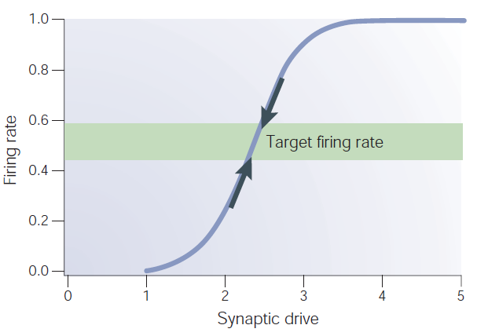
Different Forms of Plasticity
u
ω
v
Hebbian plasticity (or other, STDP) for synaptic growth or shrinkage.
Synaptic Plasticity
Homeostatic Plasticity
Firing rate homeostasis drive for synaptic (up or down) scaling.
Turrigiano and Nelson, 2004
7

Slide 8
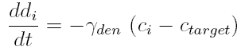
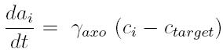
Different Forms of Plasticity
u
ω
v
Hebbian plasticity (or other, STDP) for synaptic growth or shrinkage.
Synaptic Plasticity
Homeostatic Plasticity
Firing rate homeostasis drive for synaptic (up or down) scaling.
Calcium dependent dendritic and axonal
growth or shrinkage for synapse generation or deletion
Structural Plasticity
8

Slide 9
Synaptic Plasticity + Synaptic Scaling
The Problem:
Regulation of synaptic growth in „general“ networks to avoid weight divergence and guarantee pattern storage.
9

Slide 10
Analysis
u
ω
v
General Learning Rule G
(e.g. Hebb, BCM, STDP, etc.)
General Neuron Model F
e.g. Int.&Fire, Ihzikevic, Gerstner
Synaptic Plasticity Homeostatic Plasticity =
Scaling
γ << μ << 1 as homeostasis is slower than plasticity
10

Slide 11
Analysis
u
ω
v
General Learning Rule G
(e.g. Hebb, BCM, STDP, etc.)
General Neuron Model F
e.g. Int.&Fire, Ihzikevic, Gerstner
v
v
Synaptic Plasticity Homeostatic Plasticity =
Scaling
γ << μ << 1 as homeostasis is slower than plasticity
11

Slide 12
Analysis: Plasticity Part
Taylor Expansion at ω=0 yields:
c=0 ! Otherwise one would allow for non-sensical rules like
Thus:
12

Slide 13
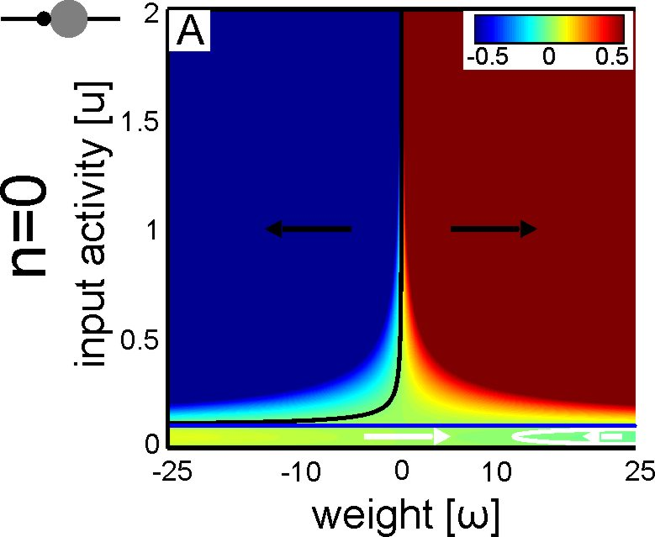
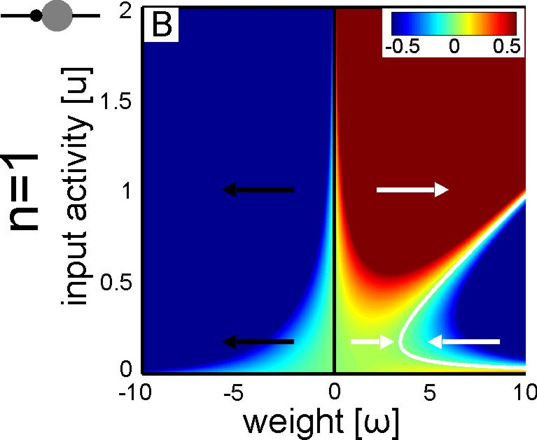
Analysis: Fixed Points:
We plot the weight change in color
Final combined rule:
Synaptic Plasticity Homeostatic Plasticity
Hebb
Hebb: positive stable
unstable
F=u, G=„Hebb“
13

Slide 14
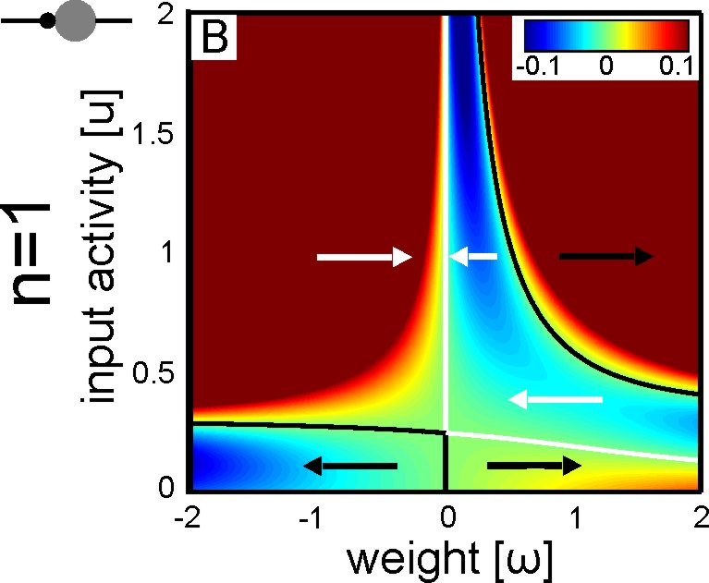
Analysis: Fixed Points:
We plot the weight change in color
BCM: unstable
Hebb: positive stable
F=u, G=„Hebb“
F=u, G=„BCM“
14

Slide 15
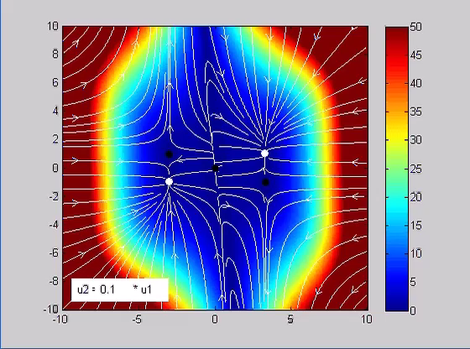
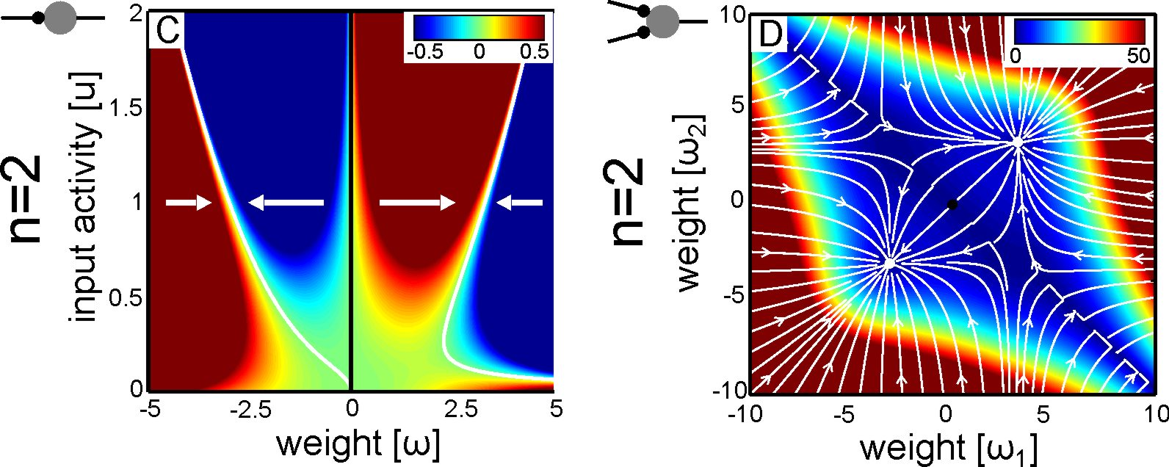
Analysis: Fixed Points
Globally Stable
15

Slide 16
Analysis: Fixed Points
Globally Stable
16

Slide 17
Analysis: Summary
Analytical Fixed Point Analysis
showed that:
For n=2, the combined plasticity+homoestasis rule is globally stable regardless of learning rule and neuron model.
17

Slide 18
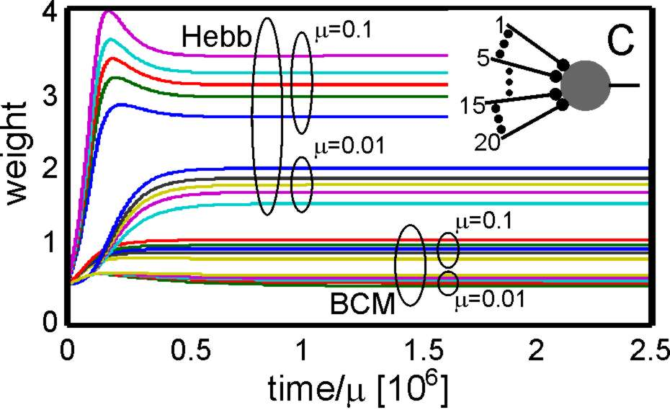
Results: Synapse Stability
18

Slide 19
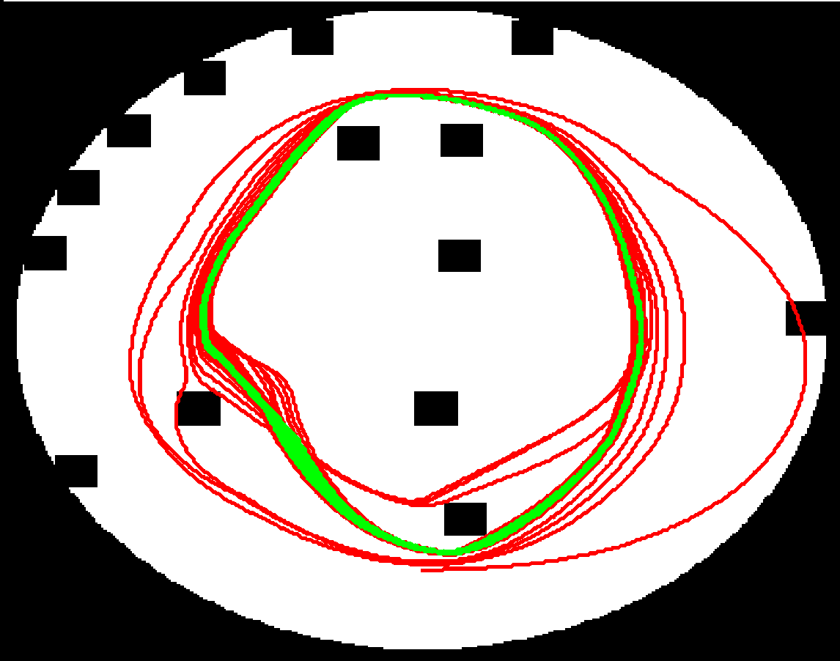
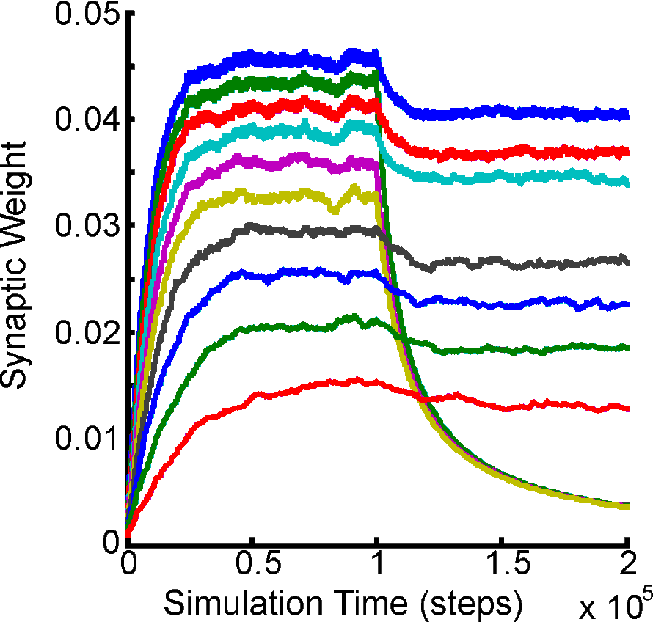
Results: Sensor Sorting
Arena with Obstacles
and Beetle Trajectory
Beetle Robot with
random sensor
sensitivity
Three antennas
randomly cut
Red: Initial phase
Green: After learning

Slide 20
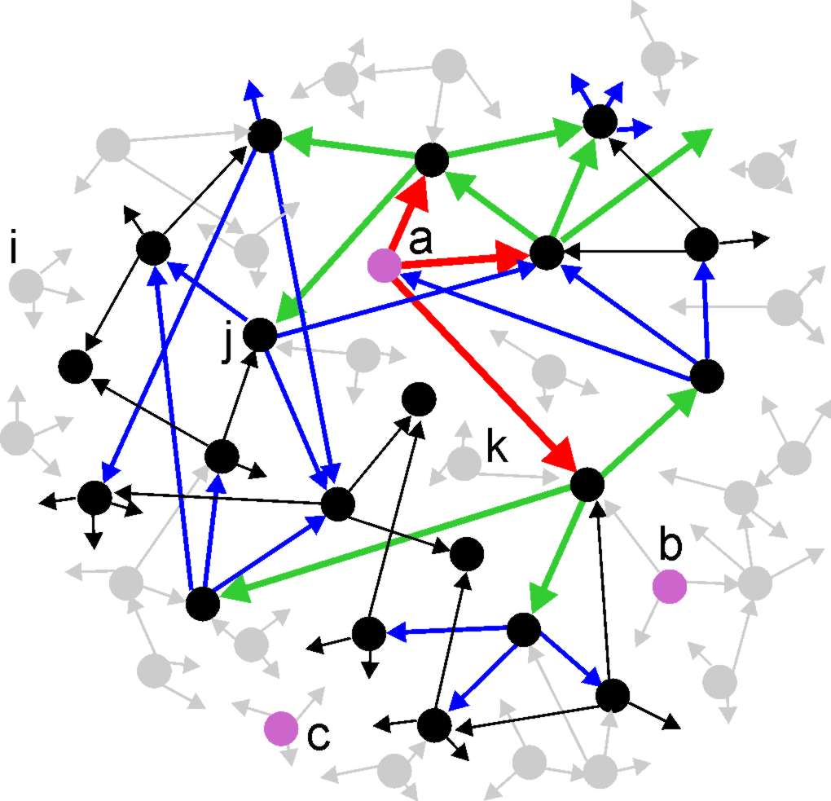
Results: Pattern Storage
100 Neurons, 3 Inputs, 3 random connections each
3.00 <= 3
11.68 < 3+9
33.50 < 3+9+27
71.88 etc.
97.95
Neurons activated
(on average) due
to recurrence.
20

Slide 21
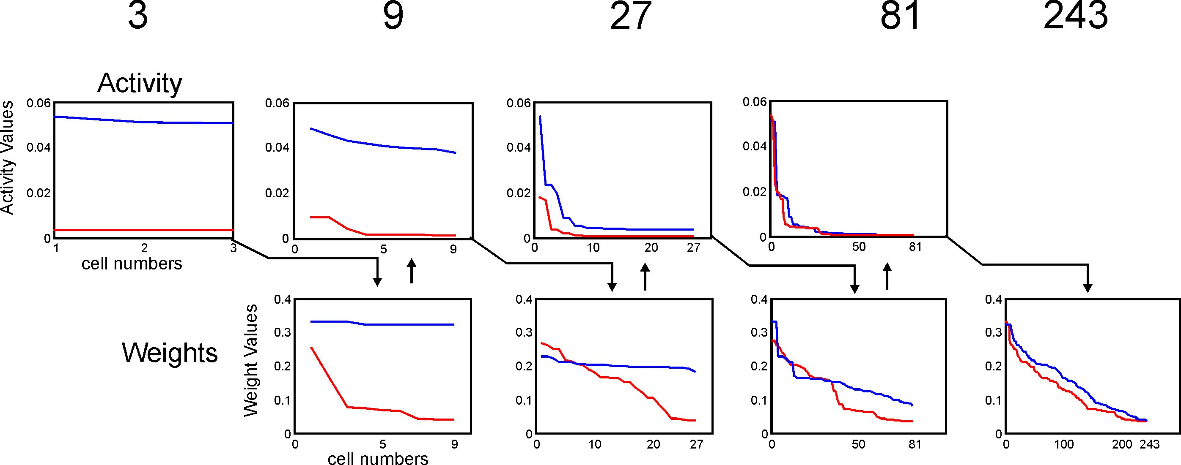
Results: Pattern Storage
*
*
*
*
*
*
Kolmogorow-Smirnoff Test, *: p<0.01
Blue: Input
Red : Control
21

Slide 22
Structural Plasticity
Axonal and dendritic changes

Slide 23
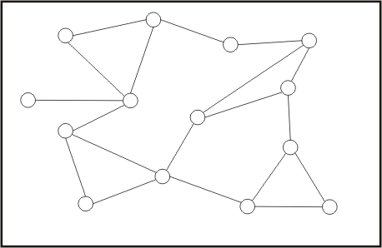
Structural Plasticity: More abstract
Structural plasticity creates and deletes synapses
23

Slide 24
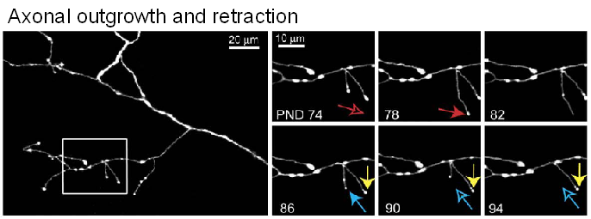
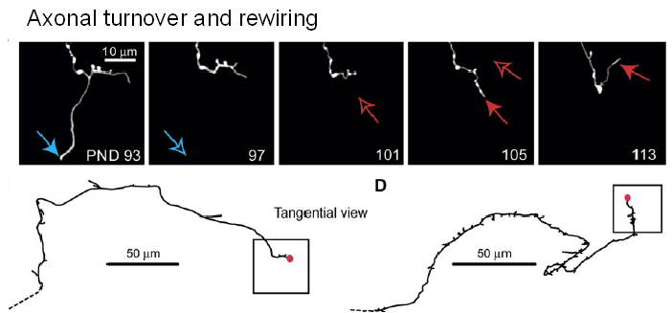
Structural plasticity of axon terminals
In-vivo 2 Photon-Laser Imaging from the cortex of living mice reveals a permanent axonal remodelling even in the adult brain leading to synaptic rewiring
Top: Axonal outgrowth/retraction
Red arrow: Axonal outgrowth
Yellow: Remains
Blue: Retracts
Middle: Rewiring
Blue: Retracts and looses synapse
Red: Grows and creates new syn.
Bottom: 3D-reconstruction of middle. Synapses shown in red. The PND93 synapse is deleted and at PND113 a new one is created.

Slide 25
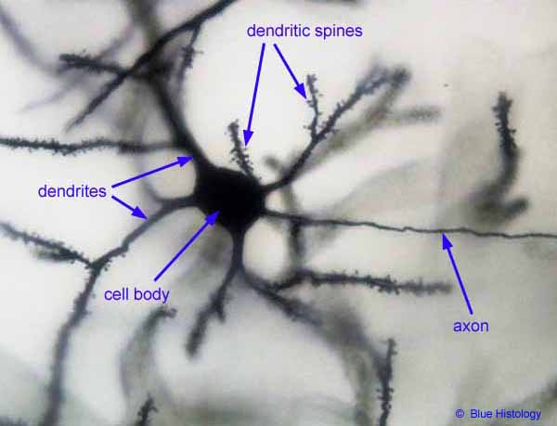
Structural plasticity of dendritic spines
Dendritic spines
2μm
Dendritic spines on an appical dendrite on a LIV-neuron in V1 of the rat
Arellano et al. (2007) Neurosci.
Spine growth precedes synapse formation
Spine formation via filopodia-shaped spines (see arrow, top figure) precedes synapse formation. Spines in synapses are rather mushroom-shaped and carry receptor plates (active zones, red, top figure). Spines contact axonal terminals or axonal varicosities in reach and form synapses (left).
Knott et al., 2006

Slide 26
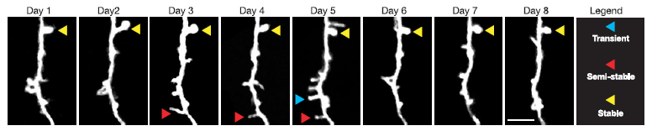
Structural plasticity of dendritic spines
Stable and transient spines
In-vivo imaging of dendritic trees within the barrel cortex of living rats
Trachtenberg et al. (2002) Nature
Spines are highly flexible structures that are responsible (together with axonal varicosities) for synaptic rewiring. Only one third of all spines are stable for more than a month. Another third is semistable, meaning that it is present for a couple of days. Transient spines appear and disappear within a day.

Slide 27
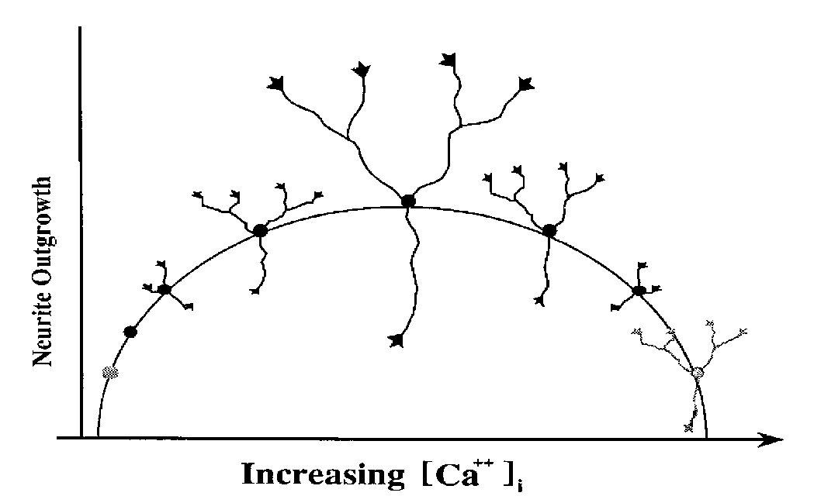
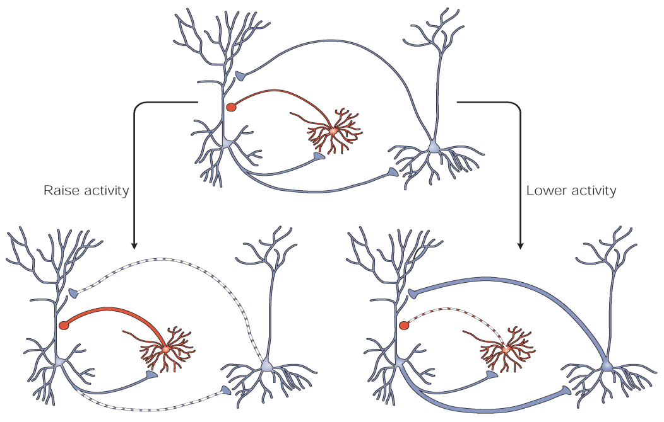
Activity shapes neuronal form and connectivity
Neuronal activity
Neuronal morphology
Morphology
Connectivity
Network connectivity
.
Neuronal activity changes the intracellular calcium. Via changes in intra-cellular calcium, neurons change their morphology with respect to their axonal and dendritic shape. This leads to changes in neuronal connectivity which, in turn, adapts neuronal activity. The goal is that by these changes neurons achieve a homeostatic equilibrium of their activity.

Slide 28
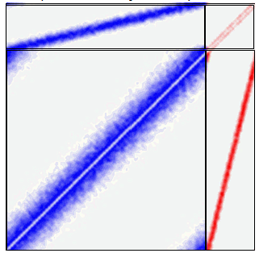
Models for structural plasticity
Connectivity
The model is...
a recurrent neural network
with simple spiking neurons
each synapse consists of a presynaptic and a postsynaptic element.
We assume that...
Neighbouring neurons have a higher chance to form synapses than distant neurons
Neurons change the number of their synaptic elements in an activity-dependent manner
Synapses are formed in a recombination step
The network yields towards homeostasis by changing its connectivity
control
Sorted connectivity (Connectivity matrix)‏
Inhibition
1 2 3 ………………80 81…100
Excitation
Neuron number
1 2 3 ………………80 81…100
Excitation
Inhibition
-10 10

Slide 29
Synapse representation and synaptic rewiring
Synapse formation
Synapse deletion
Synapse turnover
2
1
1
2
3
3
5
4
4
6
3
5
4
x
3
2
7
x
1
6
5
1
8
5
x
10
6
10
9
9
7
x
9
7
8
10
after synapse formation
after synapse deletion
Butz et al. (2008) Hippocampus
The algorithm proceeds in three steps:
Update in network activity (on a short, functional time scale)
Update in the number of free synaptic elements (and eventually synapse deletion) (on a longer, morphogenetic time scale)‏
Update in connectivity (return to step 1)‏

Slide 30
t
Activity-dependent changes in synaptic elements
Step 1) Update in neuronal activity:
Membrane potential
Firing state
Firing rate
rate
Average firing rate
Homeostatic rule
input
The firing rate is given by a standard sigmoidal function that defines the activity of a poisson-spiking neuron. The firing rate depends on the synaptic input each neuron recieves.
We compute the average firing rate of each neuron over a certain time frame. The deviation from a desired value drives morphogenetic changes of the neuron (next slide).

Slide 31
t
Activity-dependent changes in synaptic elements
Step 2) Update in synaptic elements:
Activity-dependent changes:
and
Homeostatic rule
and
A_{i}
Low activity
A_{i}
High activity
mV
D_{i}^{exc}
mV
D_{i}^{exc}
D_{i}^{inh}
t
(Axonal) presynaptic element (A)‏
(Dendritic) exc. postsynaptic element (D^{exc}) (Dendritic) inh. postsynaptic element (D^{inh})‏
When the activity of a neuron is low (left diagram), it expresses many postsynaptic excitatory elements (green) to increase the chance to get more (incoming) excitatory synapses and more activity. On the other hand it will have only few axons leaving.
If activity increases (right), the number of postsynaptic elements is decreased and instead inhibitory postsynaptic elements are formed (red). More axons will sprout.
This grounds the homeostatic behaviour of the neurons.

Slide 32
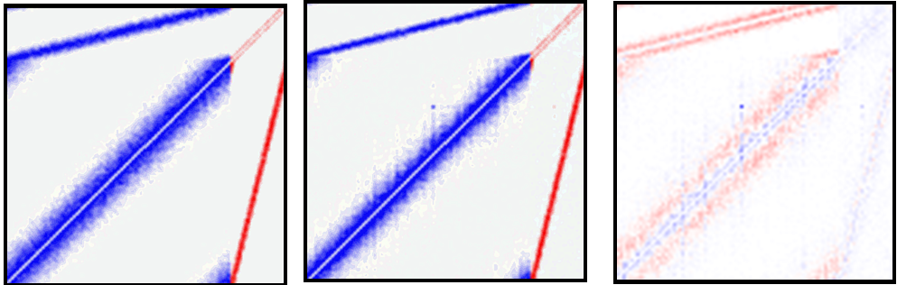
t
Activity-dependent changes in synaptic elements
Step 3) Update in connectivity
Before reorganization
After reorganization
Changes
Inhibition
Excitation
Excitation
Inhibition
Excitation
Inhibition
Excitation
Inhibition
A few changes in synaptic connectivity (above) are sufficient to balance neuronal activity of all cells homeostatically.
1
s_{i}
1
s_{i}
Activity, early
0.5
Activity, late
0.5
0
0
1
NE
N
NE
N
#neuron

Slide 33

Application to lesion-induced plasticity
It was found that following deafferentation, cortical rewiring accompanies cortical remapping.
I.e. neurons bordering the deafferented area (also called lesion projection zone, LPZ) become disinhibited because local lateral inhibition gets lost by the lesion, too.
They respond with axonal sprouting as activity promotes axonal outgrowth. The consequence is that neurons bordering the LPZ reoccupy vacant dendritic targets within the LPZ and rebalance the activity of the deafferented neurons. (Darian-Smith & Gilbert, 1994, 1995)‏
s_{i}
control
#neuron
s_{i}
disinhibition
deafferentation
disinhibition
#neuron
s_{i}
balanced activity
#neuron

Slide 34
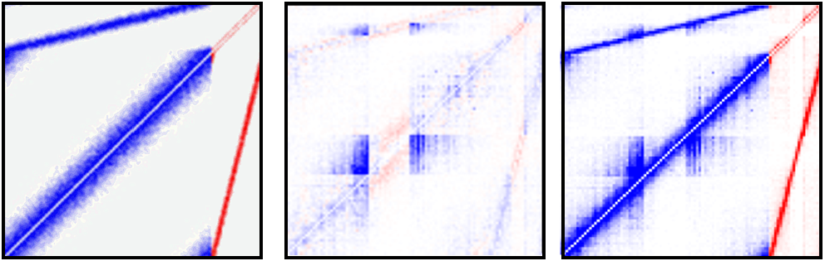
Compensatory network rewiring after deafferentation
When we reduce the input to a subset of neurons (Deafferentation), synapses are formed that would normally not occur during development but arise from a compensatory network rewiring.
We clearly see, an axonal sprouting of neighbouring neurons.
s_{i}
disinhibition
deafferentation
disinhibition
#neuron
Before reorganization
Changes
After reorganization
Inhibition
Excitation
Excitation
Inhibition
Excitation
Inhibition
Excitation
Inhibition

Slide 35
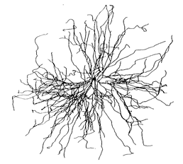
How Structural Plasticity influences network development AND activity
Simplifying the model!
Looking at developing cell cultures and
Using the aspect of self-organized criticality in the neuronal activity.

Slide 36
What is self-organized criticality (SOC)?
“critical” is a state between two different phases of a system.
f.e. the Ising model of magnetism
T_{C} Curie temperature
ferromagnetic
critical
paramagnetic
Chialvo, 2007
36

Slide 37
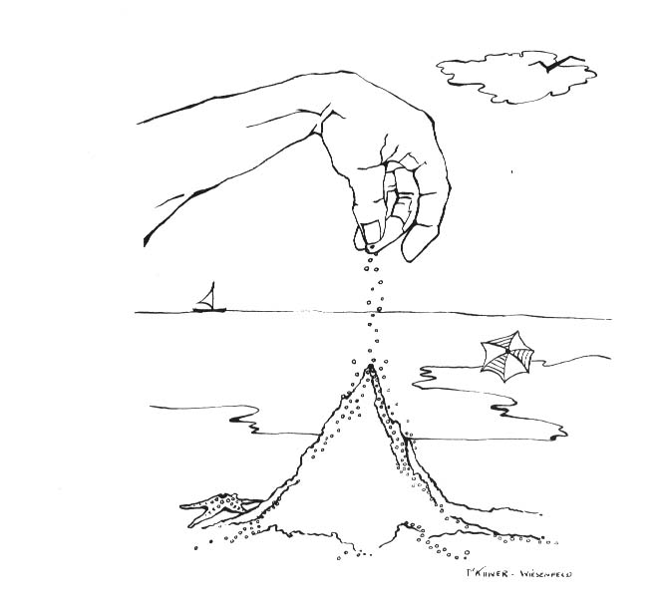
What is an avalanche?
Bak, 1996, How Nature works: The Science of Self-Organized Criticality
Now you have a scientific excuse for going to the beach.
An avalanche is an object of spatial-temporal linked events.
Size – number of events within one avalanche
Duration – time between first and last event of the avalanche
37
Notes:
37
37

Slide 38
What is self-organized criticality (SOC)?
“critical” is a state between two different phases of a system.
“self-organized” describes the property of a system to develop towards a state driven by local rules.
Properties of SOC:
The critical state is very robust against external perturbations and responds with avalanches
These avalanches are power law distributed in size and duration
Avalanches are invariant in size and duration: p(ax) = C(a) p(a)
38

Slide 39
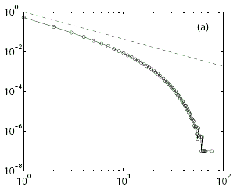
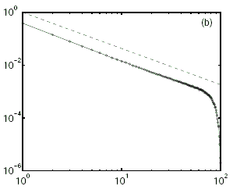
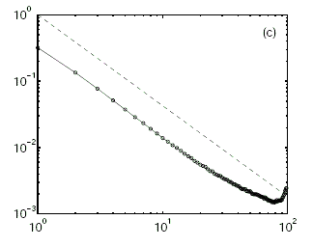
Self-Organized Criticality
(a long chapter in Physics)
Critical state – power law – linear in loglog-plot
log(P(size))
log(size)
log(size)
log(size)
Levina
et al.,2007
An avalanche is an object of spatial-temporally linked events.
Size – number of events within one avalanche
Duration – time between first and last event of the avalanche

Slide 40
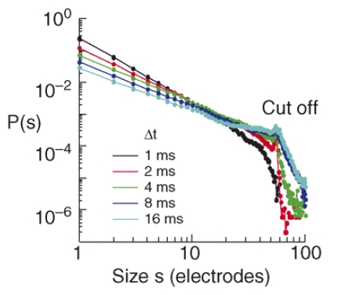
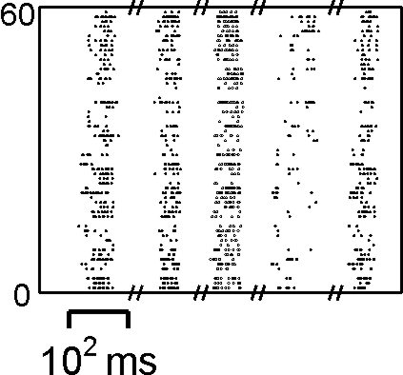
Avalanches and SOC in neuronal networks
Beggs and Plenz, 2003

Slide 41
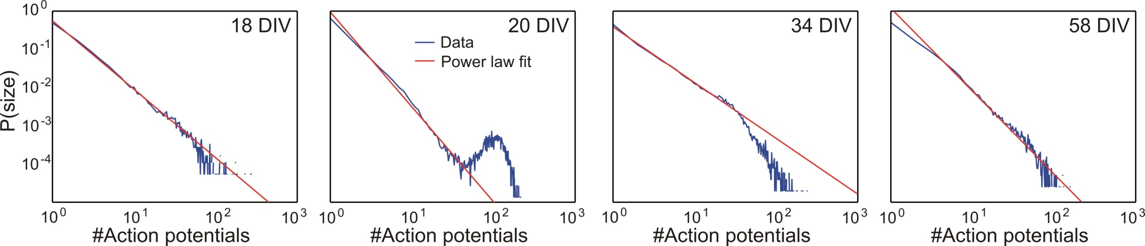
Criticality in cell cultures
Growth phase overshoot phase equilibrium phase
Poisson supercritical subcritical critical
- 20 cell cultures between day 11 and 95 in vitro have been assessed

Slide 42
The model
Circular axonal and dendritic probability spaces
Overlap determines the synaptic connectivity.
Individual shrinkage and growth following a homeostatic principle.

Slide 43
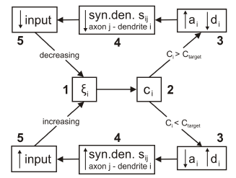
The model (without the equations)
Normal
Input
Less
Input
Less Synapses
at THIS neuron
Homeostasis Process
Axonal
Growth
&
Dendr.
Shrinkage
High
Input
High
Calcium

Slide 44
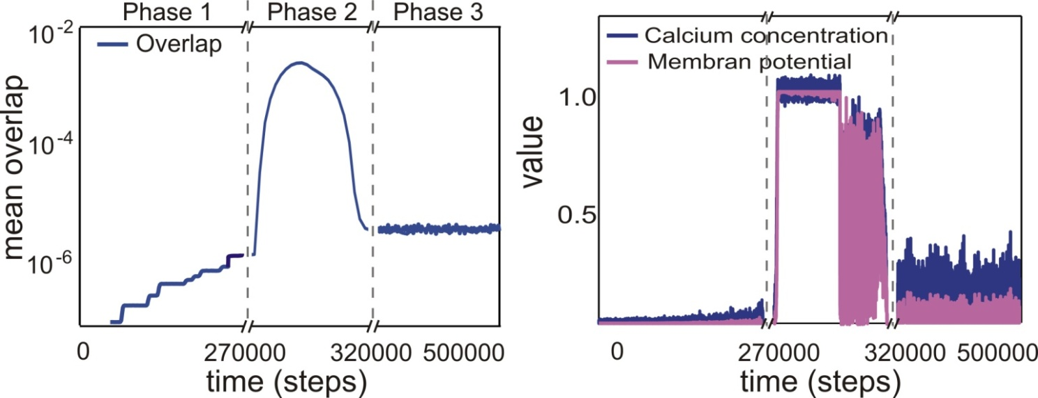
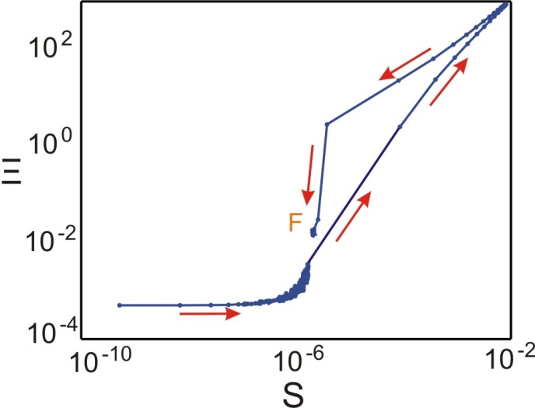
Developmental behavior of model corresponds to real cultures
Phase 1 – Outgrowth phase
Phase 2 – Overshoot/Pruning phase
Phase 3 – Equilibrium phase

Slide 45
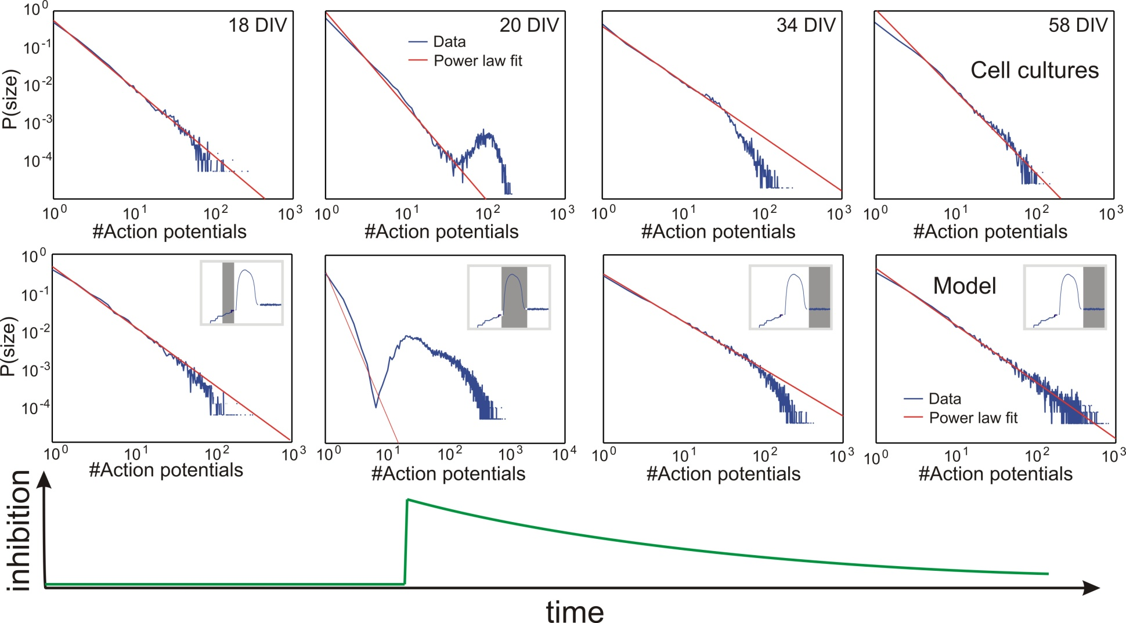
Criticality of model corresponds not to real cultures
outgrowth
overshoot & pruning
equilibrating
This state not
existing
Remains
supercritical
Eplileptiform
Activity

Slide 46

Inhibition as an additional „Ingredient“
Inhibition
Hedner et al., 1984
Jiang et al., 2005
Sutor and Luhmann, 1995
Tetzlaff et al., PLoS CB 2010
46

Slide 47
Comparison to cell cultures
outgrowth
overshoot & pruning
equilibrating

Slide 48
General Conclusion
Homeostatic principles may solve the major problem of how to stabilze complete large networks even when other plasticity mechanisms co-act and interfere.
We get globally stable synaptic patterns
AND
Relevant network stages (Self-organized criticality)

Slide 50
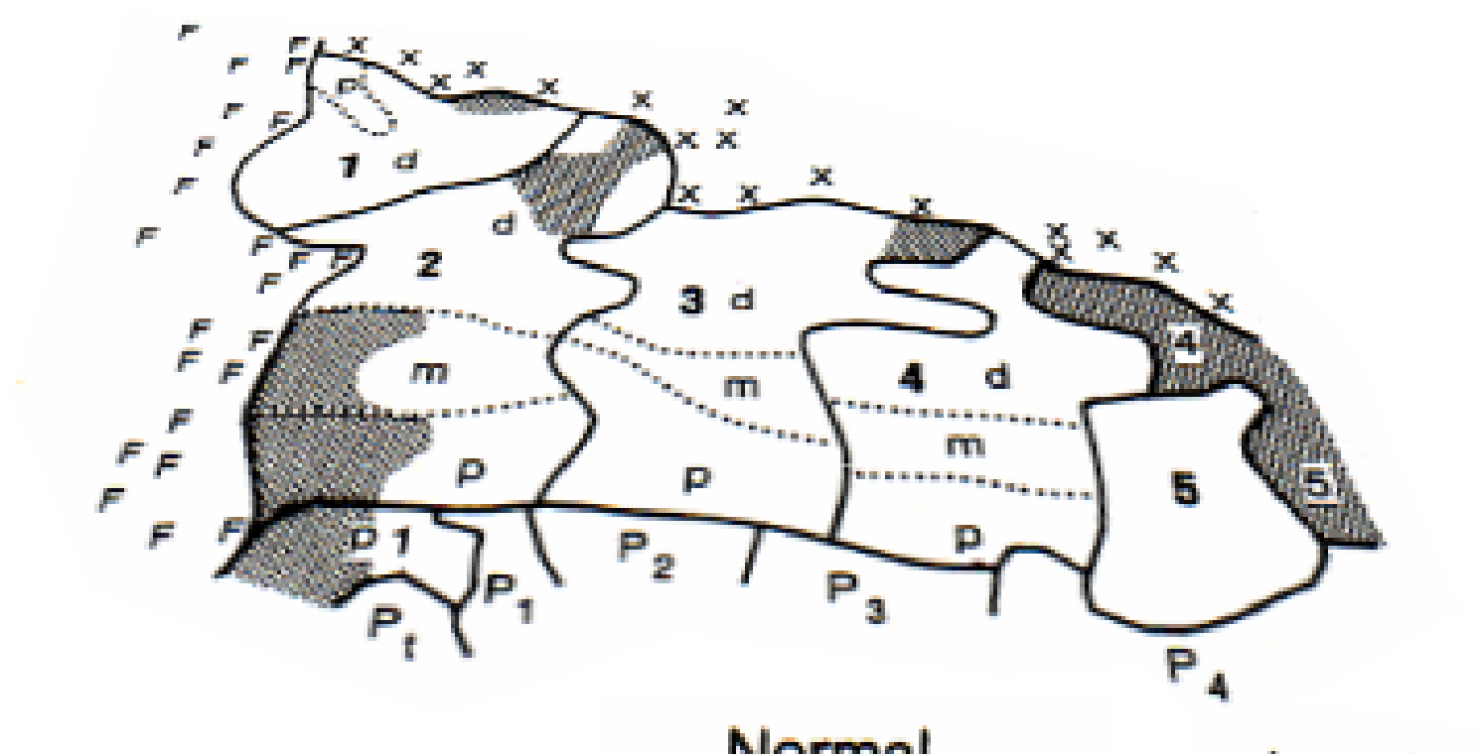

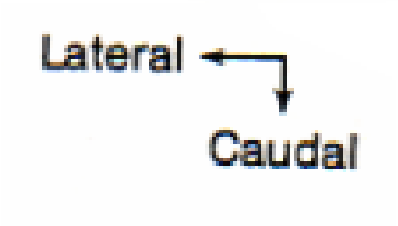

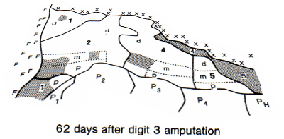
Application to lesion-induced plasticity
Modelling the rewiring of cortical maps:
Cortical remapping substantially appears after cortical lesions and changes in neural input (deafferentation). I.e. monkeys show pronounced remapping following finger amputation. Representation of the remaining fingers enlarge so that they fill the unused representations.
1-5: cortical representations of digits 1-5

Slide 51
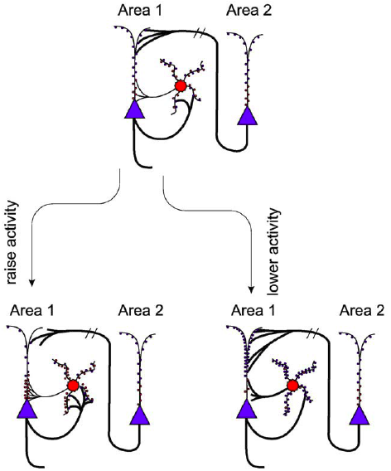
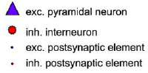
Structural plasticity
Butz et al., 2009
51

Slide 52
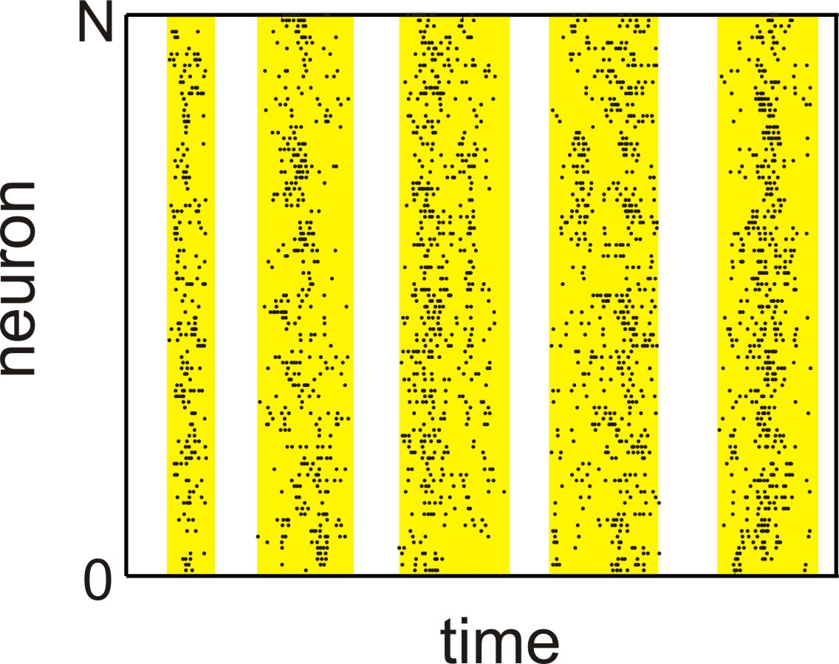
Avalanches and SOC in neuronal networks
bin width
∆t
Neuronal networks are critical.
Beggs and Plenz, 2003
52

Slide 53
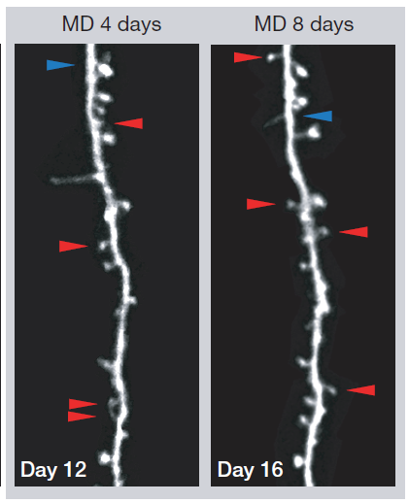
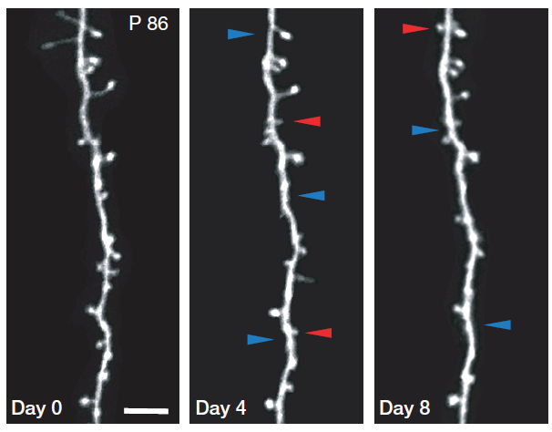
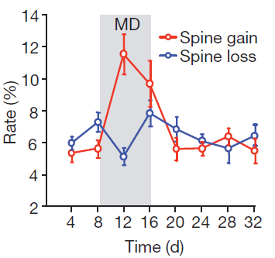
Structural plasticity
Dendrite of an
adult mouse in
the visual cortex
Hofer et al., 2009

Slide 54
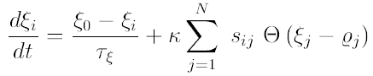
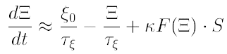
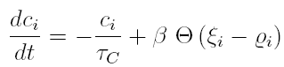



Isoclines
Tetzlaff et al., PLoS CB 2010 (in press)
54

Slide 55




Isoclines
Tetzlaff et al., PLoS CB 2010 (in press)
55

Slide 56

Outgrowth phase
no inhibition
overlap
Tetzlaff et al., PLoS CB 2010 (in press)
56

Slide 57

Overshoot/Pruning phase
without inhibition
strong inhibition
No avalanche statistic
possible:
one or two long
avalanches
Tetzlaff et al., PLoS CB 2010 (in press)
57

Slide 58

Equilibrium phase
strong inhibition
physiol. inhibition
without inhibition
Δp = -0.801(19)
Δp = -0.070(25)
Δp = 0.199(15)
Tetzlaff et al., PLoS CB 2010 (in press)
58

Slide 59
Dynamics and Fixed Points from Isoclines
Activity
Connectivity
From simplified equations
From Full Simulations
Tetzlaff et al., PLoS CB 2010 (in press)
59

Slide 60
Synaptic Plasticity + Homeostatic Plasticity
The Problem:
Regulation of synaptic growth in „general“ networks to avoid weight divergence and guarantee pattern storage.
State of the Art (1):
Weight normalization methods
Subtractive requires „global“ knowledge.
Multiplicative (Oja) scales weights proportionally.
STDP looked promising, but pattern storage difficult.
Arbitrary!
60

Slide 61
Synaptic Plasticity + Homeostatic Plasticity
State of the Art (2):
Homeostatic Synaptic Scaling
First discovered by Turrigiano et all in 1998.
Key phrase: Networks want to achieve a certain target firing rate
Takes the form of:
and should, thus, lead to weight stabilization.
Has been discussed a being also dependent on the weight.
Augmented form:
61

Slide 62


The model
Fire probability:
Circular probability spaces
80% excitatory
20% inhibitory
Calcium
concentration:
Dendritic field:
S_{ij}
Axonal field:
axonal circle
dendritic circle
Tetzlaff et al., PLoS CB 2010 (in press)
62

Slide 63
The model
Homeostasis Process
Tetzlaff et al., PLoS CB 2010 (in press)
63

Slide 65

Developing network activity
Average activity
1
During development, the network periodically shows phases of strong fluctuations in activity that arise from strong synaptic rewiring ('critical periods') until network activities have reached a homeostatic equilibrium.
Inhibitory neurons
0,5
Excitatory neurons
0,1
developing
stable
T

Slide 66

Reorganizatzion after Deafferentation
Average activity
1
Synaptic rewiring leads to a reinnervation of deafferented neurons and rebalance their activity levels.
Inhibitory neurons
0,5
Excitatory neurons
0,1
reorganizing
T
Deafferented neurons
stable

